Slide 1
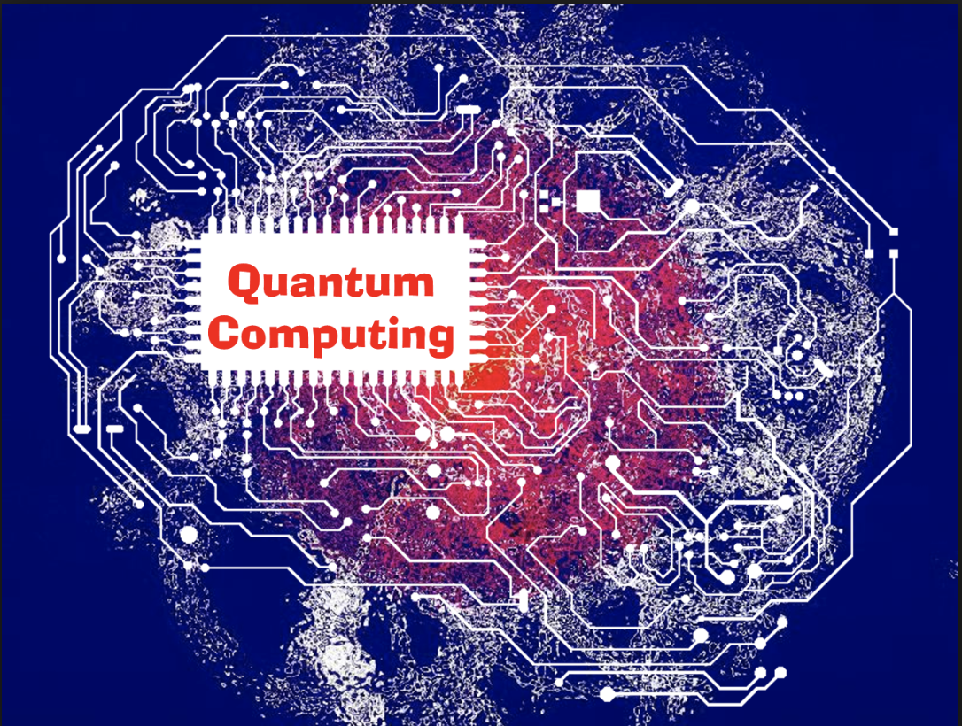
Quantum Deep Learning
Undergraduate Study #2
Hanjin Choi, Myungwoo Song. Korea University, School of Electrical Engineering
zxa018@korea.ac.kr
erados@korea.ac.kr

Slide 2



Contents
What is QAOA?
Cost Function
Applying Max-Cut to QAOA

Slide 3
What is QAOA?
Quantum
Approximate
Optimization
Algorithm

Slide 4
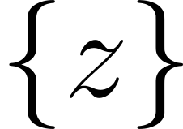
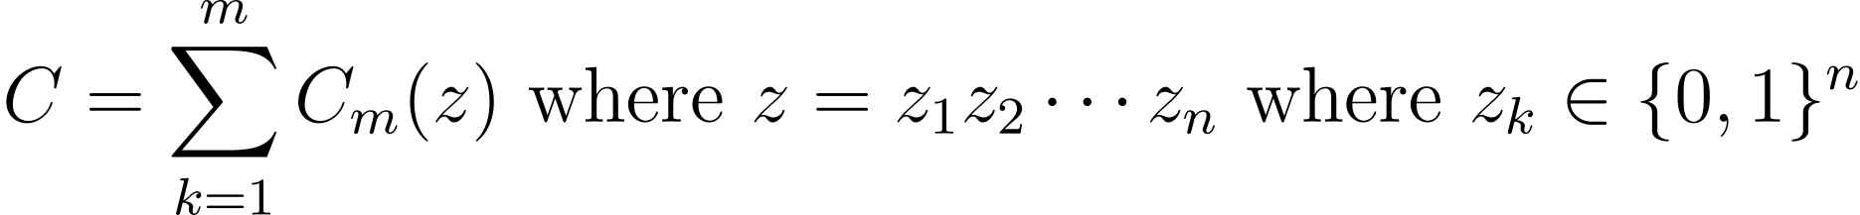

Cost Function
We want to find bit sequence , that maximize an objective function
And classically we have to query each of z which requires queries.
is too large to perform!
So we want to get approximate maximum value of the objective function C with less time complexity than .

Slide 5
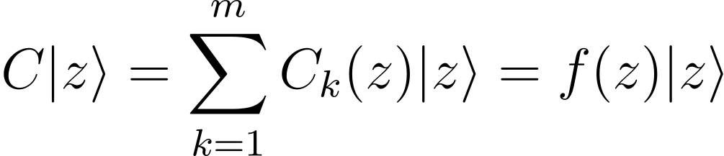
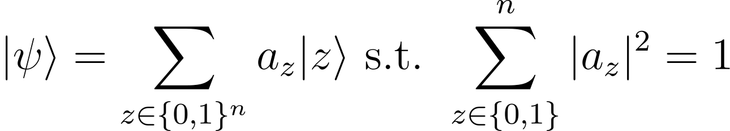

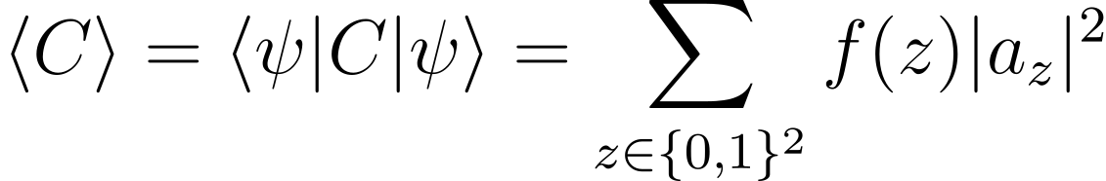
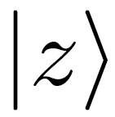

Cost Function
Treating the objective function C as an operator.
Constructing arbitrary state as general superposition state.
Finding which maximize is exactly same as finding the that maximize .

Slide 6
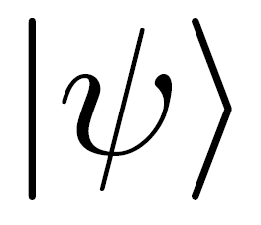


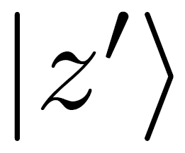
Cost Function
In order to find , we construct the initial state
Rotating to make it closer to the by two types of rotation unitary matrices

Slide 7
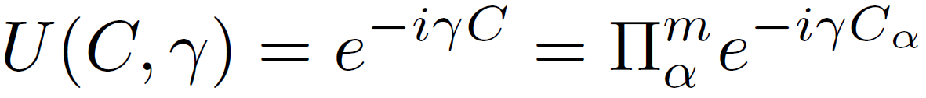

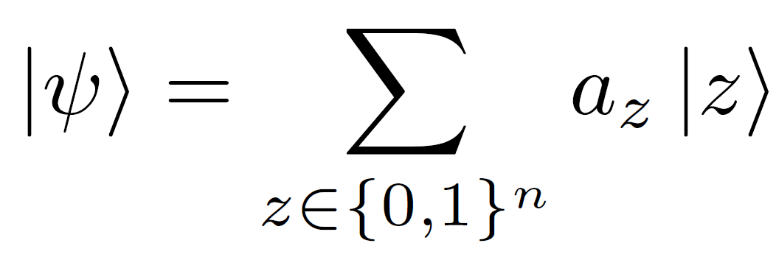
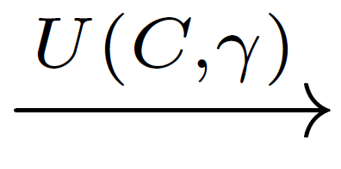
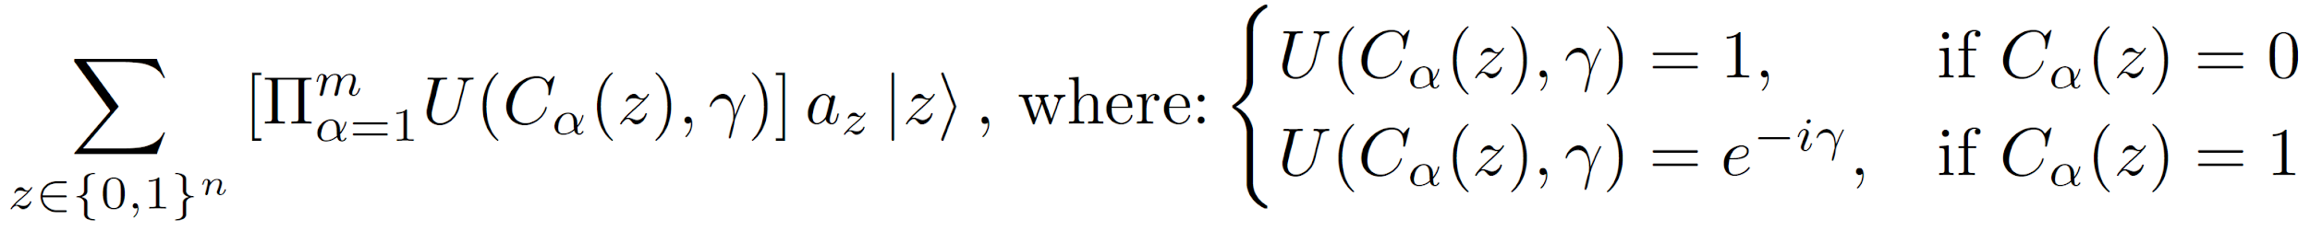


We want to rotate some component of .
If is satisfied, then a phase will be added in front of .

Slide 8
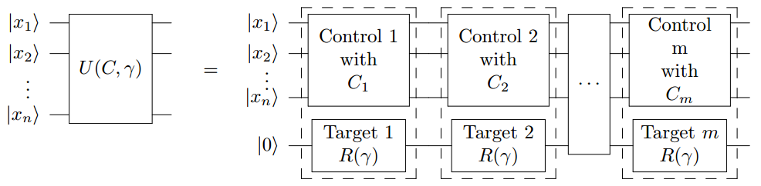
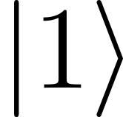

- circuit form
A circuit of would look like this

Slide 9
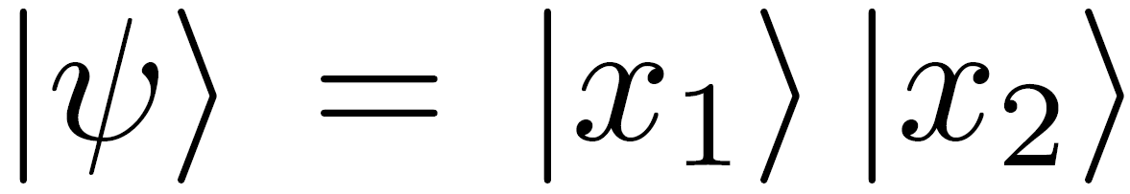


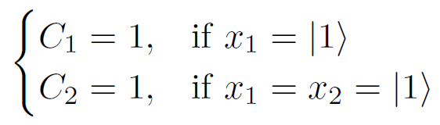







- 2 qubits example
Suppose a state .
In general ,
Let C be
For operator, we expect the result:

Slide 10

Phase change alone does not change the probability of obtaining a certain basis.
So we have to introduce rotation operator ,
where .
Change probability amplitudes

Slide 11
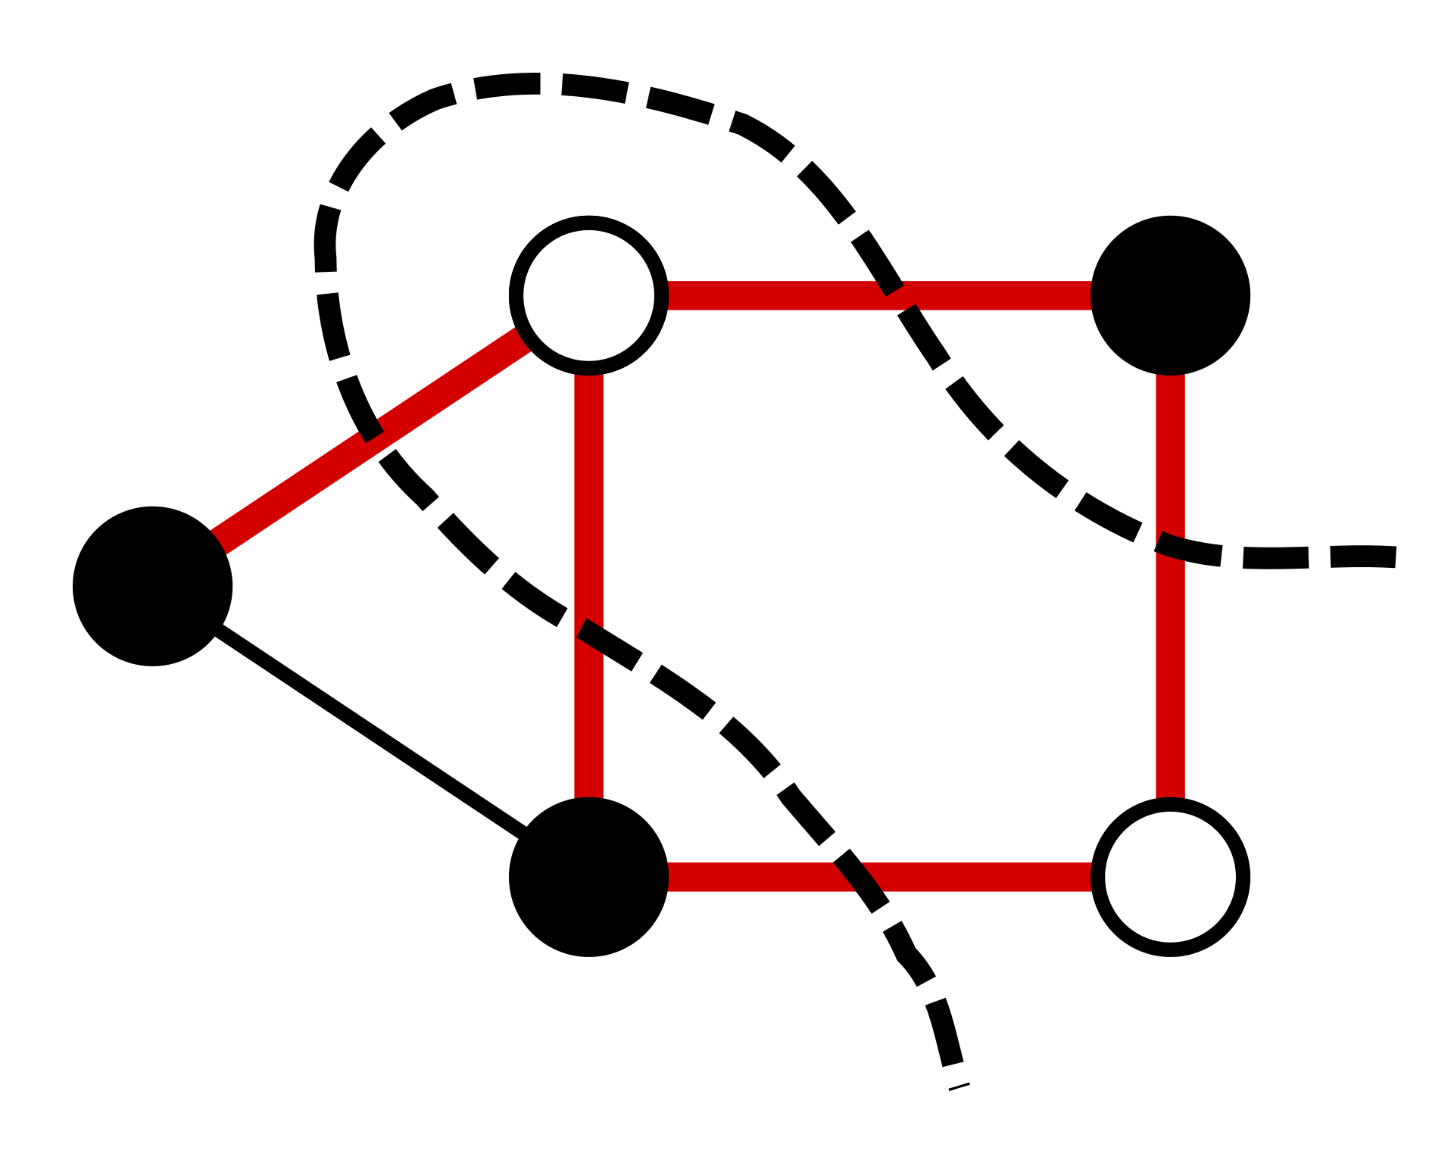
Applying Max-Cut to QAOA - Max-Cut Problem
Max-Cut Problem is finding a maximum cut of a graph.
Max-Cut Problem is NP-hard. So there is no polynomial-time algorithms for Max-Cut in general graphs.
The polynomial-time approximation algorithm for Max-Cut achieves an approximation ratio
𝞪 ≈ 0.878
Maximum cut is a cut whose size is at least the size of other cut.
An example of a maximum cut

Slide 12


Applying Max-Cut to QAOA - 1
Classical Cost Function
Quantum Operator
(Hint : Eigenvalue)

Slide 13

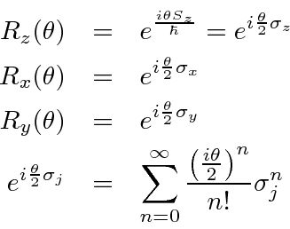
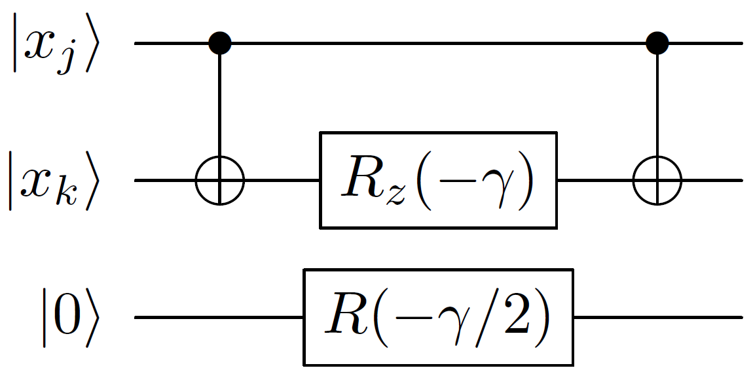
Applying Max-Cut to QAOA - 2
Applying .
Circuit implementation where .

Slide 14
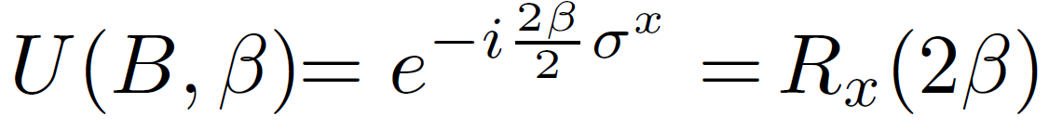
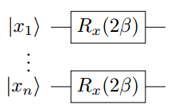
Applying Max-Cut to QAOA - 3
Applying .
Circuit implementation where .

Slide 15
Q/A
Thank you!
Any questions?

